Slide 1
Chapter 3
Interpersonal Communication and Perception
RECAP BOXES
This multimedia product and its contents are protected under copyright law. The following are prohibited by law:
any public performance or display, including transmission of any image over a network;
preparation of any derivative work, including the extraction, in whole or in part, of any images;
any rental, lease, or lending of the program

Slide 2
Learning Objectives After reading this chapter, you should be able to:
3.1 Define perception, and explain the three stages of interpersonal perception.
3.2 List and describe the strategies we use to form impressions of others.
3.3 List and describe the strategies we use to interpret the behavior of others.
3.4 Identify the eight factors that distort the accuracy of interpersonal perception.
3.5 Identify and apply five suggestions for improving interpersonal perception.

Slide 3
Understanding Interpersonal Perception (1 of 5) 3.1 Define perception, and explain the three stages of interpersonal perception.
Defining Perception
Your perceptions of people go beyond simple interpretations of sensory information.
Interpersonal perception
Passive perception
Active perception
Notes:
Perception: the process of experiencing the world and making sense out of what you experience
Interpersonal perception: process of selecting, organizing, and interpreting your observations of other people
Passive perception: perception that occurs without conscious effort, simply in response to one’s surroundings
Active perception: perception that occurs because you seek out specific information through intentional observation and questioning

Slide 4
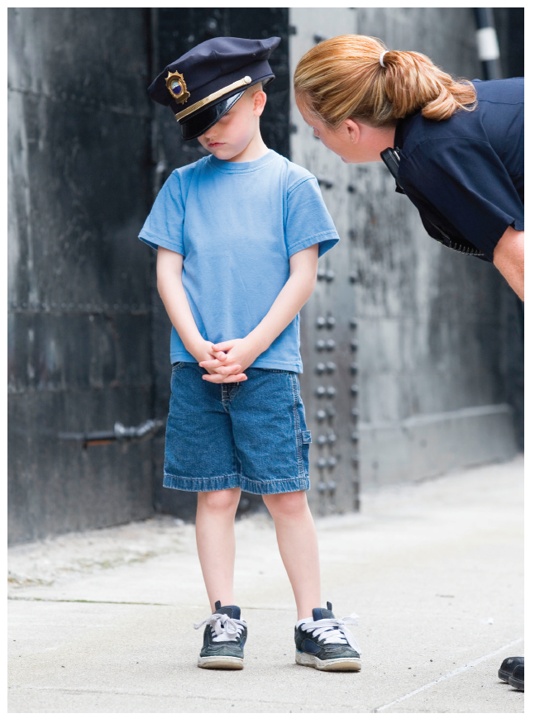
Understanding Interpersonal Perception (2 of 5)
What do you think is happening in this photograph? Your interpretation reflects interpersonal perception.

Slide 5
Understanding Interpersonal Perception (3 of 5)
The Stages of Perception
Stage 1: Selecting
We perceive and remember selectively
Selective perception
Selective attention
Selective exposure
Selective recall
We thin slice.
Notes:
Selective perception: process of seeing, hearing, or making sense of the world around us based on factors as our personality, beliefs, attitudes, hopes, fears, and culture, as well as what we like and don’t like
Selective attention: process of focusing on specific stimuli, locking on to somethings in the environment and ignoring others
Selective exposure: tendency to put ourselves in situations that reinforce our attitudes, beliefs, values, or behaviors
Selective recall: process that occurs when we remember things we want to remember and forget or repress things that are unpleasant, uncomfortable, or unimportant to us
Thin-slicing: observing a small sample of someone’s behavior and then making a generalization about what the person is like, based on the sample

Slide 6

Understanding Interpersonal Perception (4 of 5)
When we observe others, we gather information about them and ascribe motives and causes to their behaviors—sometimes incorrectly. What do you perceive about this couple’s relationship? What might they be discussing?

Slide 7
Understanding Interpersonal Perception (5 of 5)
The Stages of Perception (continued)
Stage 2: Organizing
Cognitive schema
We create, or superimpose, categories.
We link categories through punctuation.
We seek closure.
Stage 3: Interpreting
Notes:
Cognitive schema: a mental framework used to organize and categorize human experiences
Superimpose: to place a familiar structure on information you select
Punctuation: process of making sense out of stimuli by grouping, dividing, organizing, separating, and categorizing information
Closure: process of filling in missing information or gaps in what we perceive

Slide 8
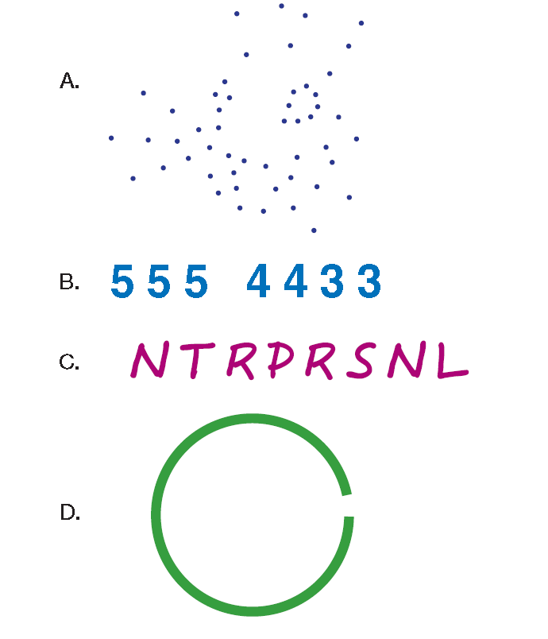
Figure 3.1 What do you see?

Slide 9
Forming Impressions of Others (1 of 5) 3.2 List and describe the strategies we use to form impressions of others.
The perceptions you use to interpret behavior are impressions.
Impression formation theory explains how we form use, and interpret perceptions about people.
Notes:
Impressions: collection of perceptions about others that you maintain and use to interpret their behaviors
Impression formation theory: explains how you develop perceptions about people and how you maintain and use those perceptions to interpret those behaviors

Slide 10

Forming Impressions of Others (2 of 5)
We Develop Our Own Theories About Others
Implicit personality theory consists of the personal assumptions you make about other people’s personalities.
We develop categories, or constructs.
Uncertainty reduction theory → Closure
Implicit assumptions and expectations
color our impressions of others.
Notes:
Implicit personality theory: your unique set of beliefs and hypotheses about what people are like
Construct: bipolar quality or continuum used to classify people
Uncertainty reduction theory: claims people seek information in order to reduce uncertainty, thus achieving control and predictability

Slide 11
Forming Impressions of Others (3 of 5)
We Form Impressions of Others Online: The Social Media Effect
Others evaluate you in interpersonal situations based on what you post on social media.
What others say about you on social media has a greater impact on whether you are perceived positively or negatively than what you post about yourself.

Slide 12
Forming Impressions of Others (4 or 5)
We Emphasize What Comes First: The Primacy Effect
Developed by Solomon Asch
Predicted outcome theory (POV) helps explain the primacy effect in interpersonal relationships.
Notes:
Primacy effect: tendency to attend to the first pieces of information observed about a person in order to form an impression
Predicted outcome theory (POV): people predict the future of a relationship based on how they size up someone during their first interaction

Slide 13
Forming Impressions of Others (5 of 5)
We Emphasize What Comes Last: The Recency Effect
We Generalize Positive Qualities to Others: The Halo Effect
We Generalize Negative Qualities to Others: the Horn Effect
Notes:
Recency effect: tendency to attend to the most recent information observed about another person in order to form or modify an impression
Halo effect: attributing a variety of positive qualities to those you like
Horn effect: attributing a variety of negative qualities to those you dislike

Slide 14
Interpreting the Behavior of Others (1 of 3) 3.3 List and describe the strategies we use to interpret the behaviors of others.
We Attribute Motives to Others’ Behavior: Attribution Theory
Attribution theory
Casual attribution theory
Notes:
Attribution theory: theory that explains how you generate explanations for people’s behaviors
Casual attribution theory: identifies the cause of a person’s actions as circumstance, a stimulus, or the person himself or herself

Slide 15
Interpreting the Behavior of Others (2 of 3)
We Use Our Own Point of Reference About Power: Standpoint Theory
Developed by Georg Hegel
Explains why people see the world differently, particularly in terms of power and influence
Notes:
Stand-point theory: a person’s social position, power, or cultural background influences how the person perceives the behavior of others

Slide 16

Interpreting the Behavior of Others (3 of 3)
We Draw on Our Own Cultural Background: Intercultural Communication Theory
Cultural elements include
Material culture
Social institutions
Belief systems
Aesthetics
Language
Notes:
Culture: Learned system of knowledge, behavior, attitudes, beliefs, values, and norms shared by a group of people.

Slide 17
Identifying Barriers to Accurate Interpersonal Perception (1 of 6) 3.4 Identify the eight factors that distort the accuracy of interpersonal perception
We Stereotype
We stereotype to meet our own needs for power, authority and structure.
We also overgeneralize.
We Ignore Information
We tend to explain a person’s motives on the basis of what is most obvious rather than the in-depth information we might have.
Social identity model of deindividuation effects (SIDE)
Notes:
Stereotype: to place a person or group of persons into inflexible, all-encompassing category
Social identity model of deindividuation effects (SIDE): theory that people are more likely to stereotype others with whom they interact online, because such interactions provide fewer relationship cues and the cues take longer to emerge than they would in face-to-face interactions

Slide 18
Identifying Barriers to Accurate Interpersonal Perception (2 of 6)
We Impose Consistency
We overestimate the consistency and constancy of others’ behaviors when organizing perceptions; we believe that if someone acts one way today, he or she will continue to act that way in the future.
We Focus on the Negative

Slide 19
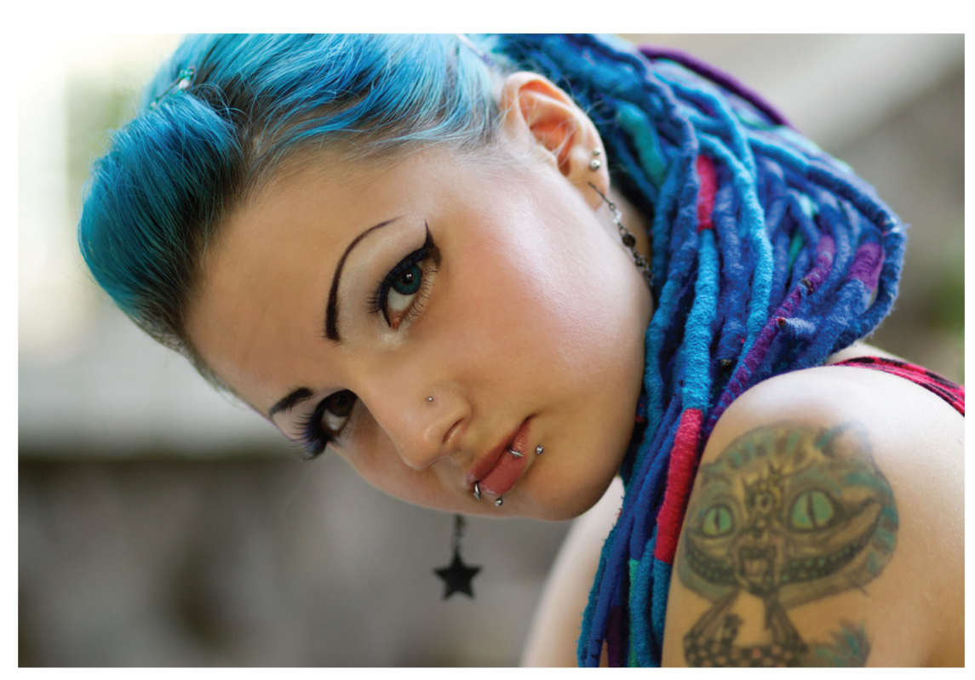
Identifying Barriers to Accurate Interpersonal Perception (3 of 6)
Stereotypes can help us make sense out of the wide range of stimuli we encounter everyday. But we also need to be sure that we don’t overuse stereotypes and thus fail to see people as individuals.

Slide 20
Identifying Barriers to Accurate Interpersonal Perception (4 of 6)
We Blame Others, Assuming They Have Control
Fundamental attribution error can be avoided by honestly examining our role in the communication process. → from Attribution theory
Notes:
Fundamental attribution error: an error that arises from attributing another person’s behavior to internal, controllable causes rather than to external, uncontrollable causes

Slide 21
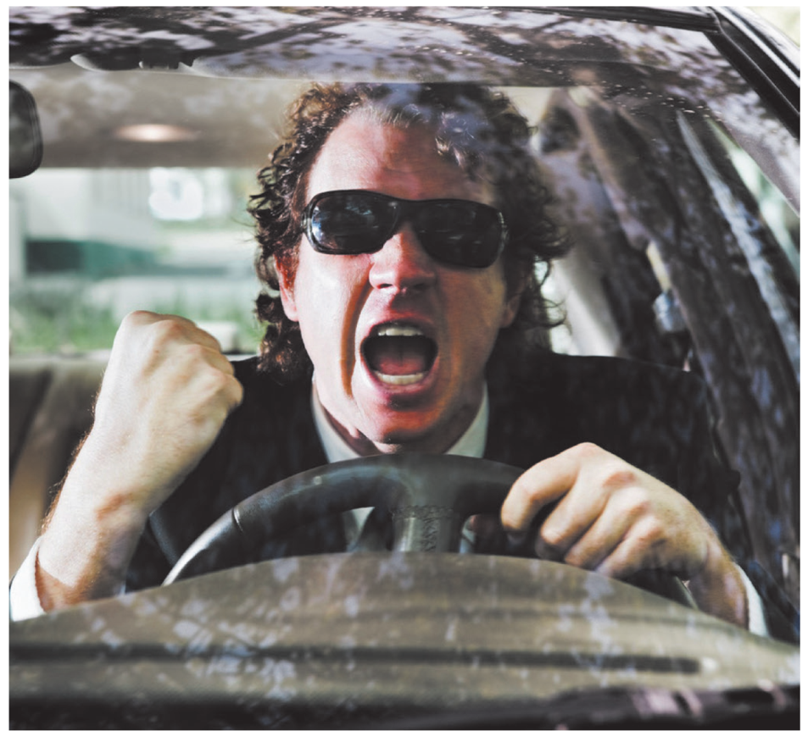
Identifying Barriers to Accurate Interpersonal Perception (5 of 6)
This driver may be making the fundamental attribution error—assuming that the other person’s behavior was under his control, when in fact it may not have been.
Notes:
Fundamental attribution error: an error that arises from attributing another person’s behavior to internal, controllable causes rather than to external, uncontrollable causes

Slide 22
Identifying Barriers to Accurate Interpersonal Perception (6 of 6)
We Avoid Responsibility
People are more likely to save face by believing that they are not the cause of a problem.
Self-serving bias
Notes:
Self-serving bias: the tendency to perceive our own behavior as more positive than others’ behaviors

Slide 23
Improving Interpersonal Perception Skills (1 of 4) 3.5 Identify and apply five suggestions for improving interpersonal perception.
Beware of Your Personal Perception Barriers → what we just talked about
You can’t assume that you (and everybody else) will always enact perception barriers.
Becoming familiar with the perception barriers that you are susceptible to will help you draw more accurate perception conclusions in the future.

Slide 24
Improving Interpersonal Perception Skills (2 of 4)
Be Mindful of the Behaviors that Create Meaning for You → it probably works the same for others
Link Details with the Big Picture → Don’t generalize
Accurate perception begins with taking a big picture approach as they look for clues about a person; don’t form a quick or rigid judgment as it may be inaccurate.
Notes:
Mindful: being conscious of what you are doing, thinking, and sensing at any given moment

Slide 25
Improving Interpersonal Perception Skills (3 of 4)
Be Aware of Others’ Perceptions of You
Accept feedback; it’s difficult to be objective about our own behavior.
Check Your Perceptions
You can check your perceptions of others in two ways.
Indirect perception checking → Observing/Listening
Direct perception checking → “Right?”
Notes:
Indirect perception checking: seeking through passive perception, such as observing and listening, additional information to confirm or refute interpretations you are making
Direct perception checking: asking for confirmation from the observed person of an interpretation of a perception about him or her

Slide 26
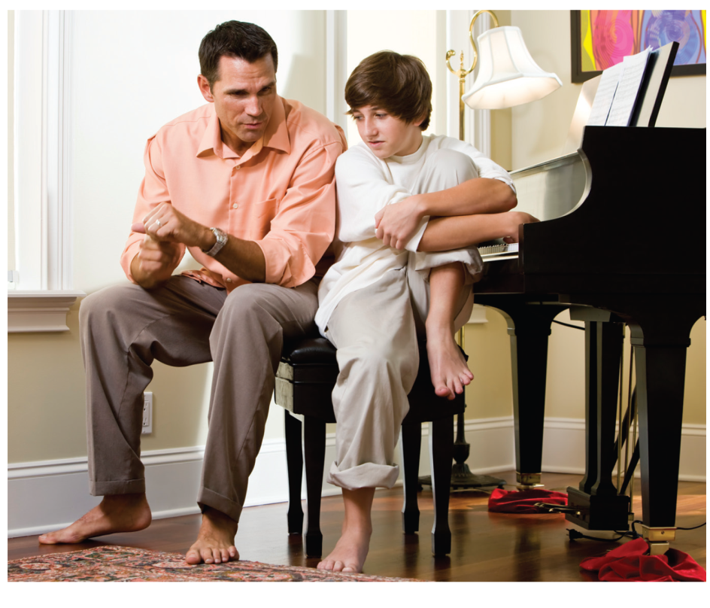
Improving Interpersonal Perception Skills (4 of 4)
Become Other-Oriented
Accurate interpersonal perception depends on the ability to understand where others are coming from.
Do you think this father is using direct perception checking, indirect perception checking, or a combination of the two?
Notes:
Indirect perception checking: seeking through passive perception, such as observing and listening, additional information to confirm or refute interpretations you are making
Direct perception checking: asking for confirmation from the observed person of an interpretation of a perception about him or her

